Slide 1
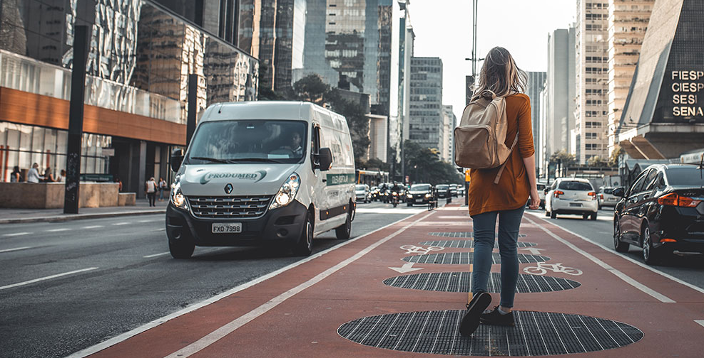
Top Restaurants and Auto Thefts in Toronto, Canada
Jeff Slee
February 23, 2021

Slide 2
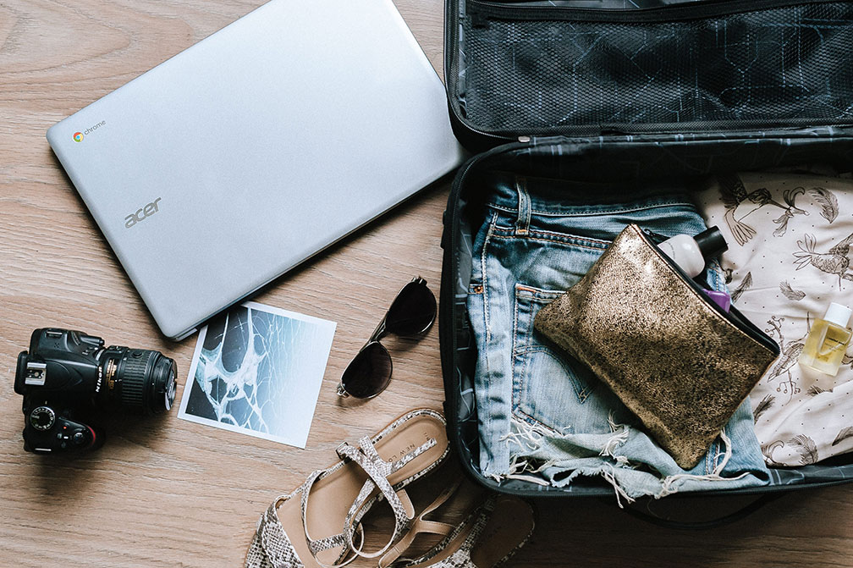
Case study When visiting Toronto, travelers will want to:
Know where to find top restaurants
Avoid high crime neighbourhoods

Slide 3
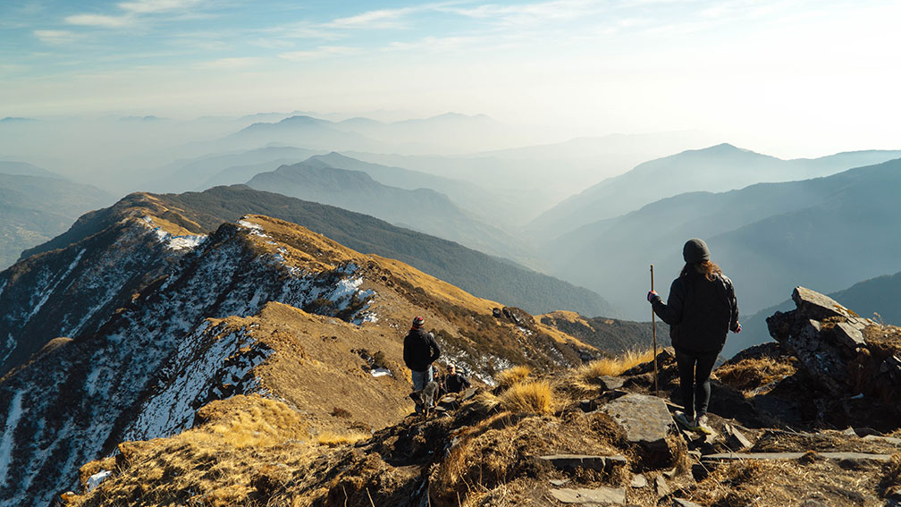
This will appeal to:  Travelers  Travel companies  New restaurant owners

Slide 4

Gathering neighbourhoods
First Step:
Web scrap from Wikipedia, using BeautifulSoup
Use geocoder to return longitude and latitude coordinates
Compare with centroids from the City of Toronto’s boundary file
Centroids appear more accurate and will be used to mark neighbourhoods
There are a total of 140 neighbourhoods in Toronto

Slide 5
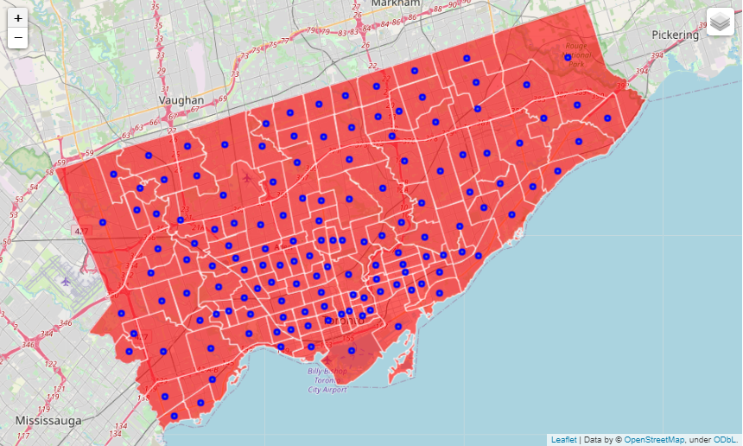
Map 1: Toronto Neighbourhoods & Centroids

Slide 6
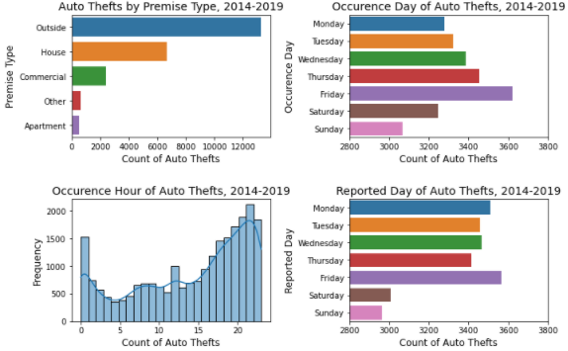
Auto thefts
Second step:
Graph 1: Auto theft statistics in Toronto
Data is from Toronto Police Services, covering auto thefts and crime rates by neighbourhood during 2014 to 2019
Contains a total of 23,380 auto thefts across 9,016 unique locations, for which a total theft count is derived.
Auto thefts increase steadily from ~3:00PM, also a big jump seen at around lunch, then decline in the early morning
Most auto thefts occur Friday evenings, peaking at ~10:00PM, away from the main place of residence
Will split neighbourhoods into three clusters based on common auto theft characteristics

Slide 7
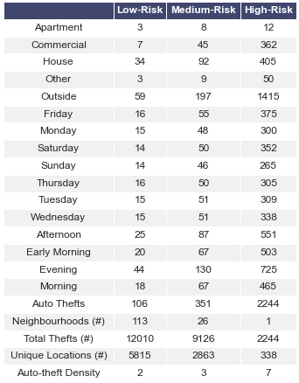
Clustering
Third step:
Table 1: Average number auto thefts by cluster
Selected features are scaled and centered from the auto thefts dataset
The elbow method is used to determine the best “k”
Three clusters are identified – low-risk, medium-risk and high-risk neighbourhoods
The low-risk cluster will be used to filter for restaurants

Slide 8
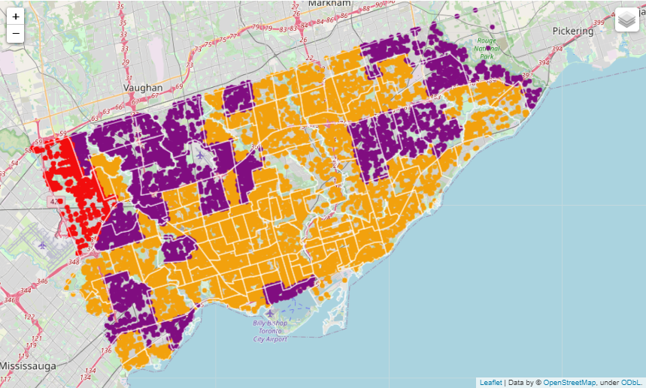
Map 2: Toronto Neighbourhood Clustering
Low-risk
Medium-risk
High-risk

Slide 9
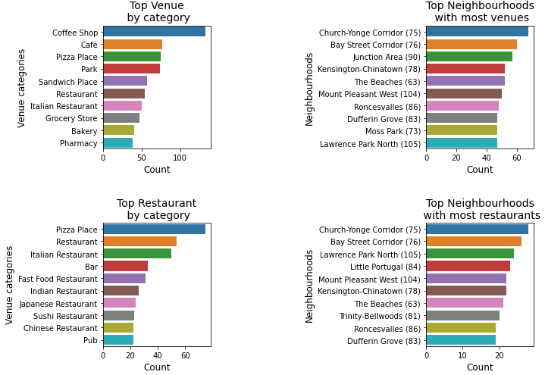
Top rated restaurants
Fourth step:
Foursquare API is used to find all venues based on locations of each neighbourhood
There are 1,536 venues, with 288 categories. The top venues are coffee shops
A total of 698 restaurants are identified based on key words in the category description. Pizza places are the top restaurant
Church-Young Corridor neighbourhood has the highest number of both venues and restaurants
There are 631 restaurants in low-risk neighbourhoods
Graph 2: Top venues and restaurants

Slide 10
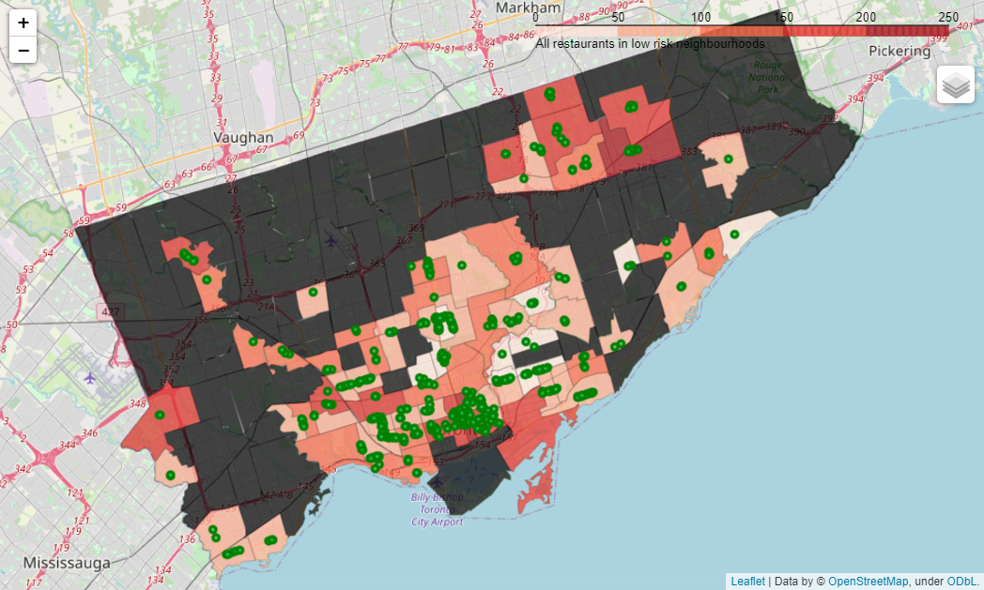
Map 3: Toronto Restaurants in Low-Risk Neighbourhoods

Slide 11

Top restaurants in low-risk neighbourhoods
Final step:
Haversine formula is used to measure distance between locations of all restaurants and auto thefts
Auto theft counts are aggregated for each restaurant around a half-kilometer radius
The top ten restaurants are identified based on the lowest number of auto thefts
Top restaurant is the Granite Club with only a single auto theft, however the private membership initiation fee is $53,000!!
Looks like it will be Pizza Nova, the second best choice.

Slide 12
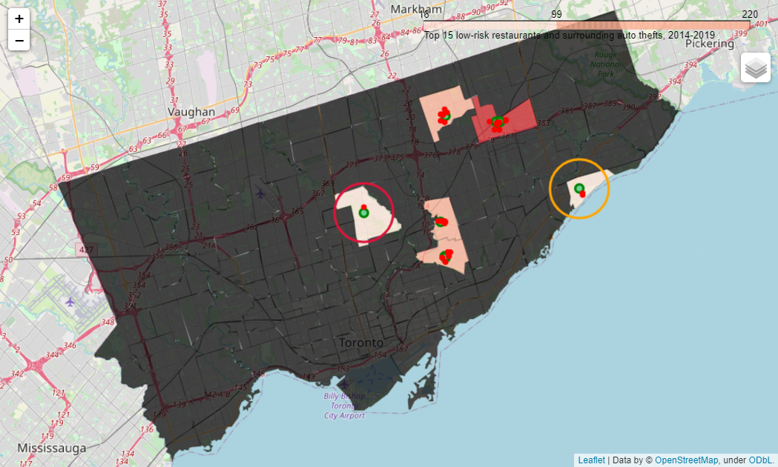
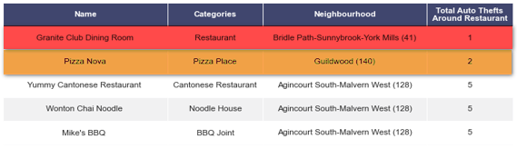
Map 4: Top Restaurants in Low-Risk Neighbourhoods

Slide 13
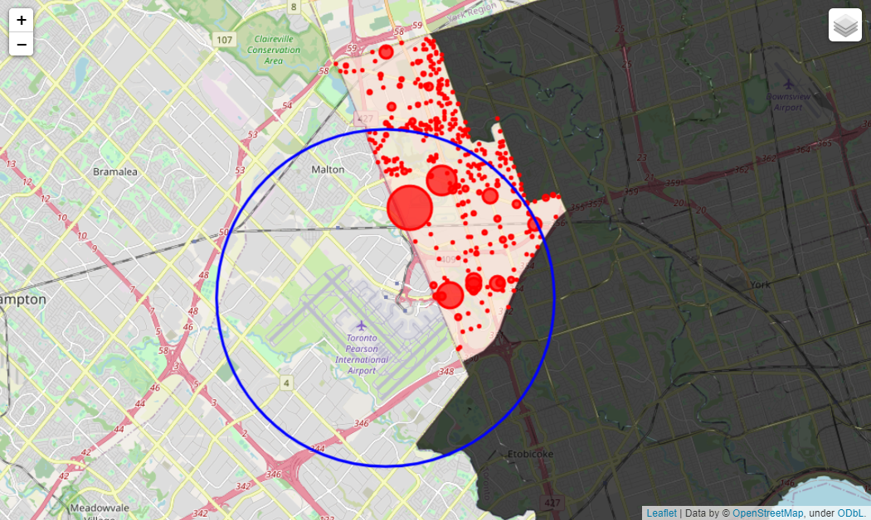
High-Risk Neighbourhoods
Additional insight:
There are 2,244 auto thefts located in a single neighbourhood, West Humber-Clairville
Account for 10% of all auto thefts in Toronto, between 2014 and 2019
Over 60% occur within 5 KM radius from the departures gate of the Toronto Pearson International Airport
Evidence of “hot zones”, indicated by the larger circles, concentrated around parking lots.
Travellers commuting from outside of Toronto may be unaware of the risks of parking near the airport
Map 5: Auto Thefts Around Toronto Pearson Airport

Slide 14

THANK YOU
www.linkedin.com/in/jeff-slee

